Slide 1

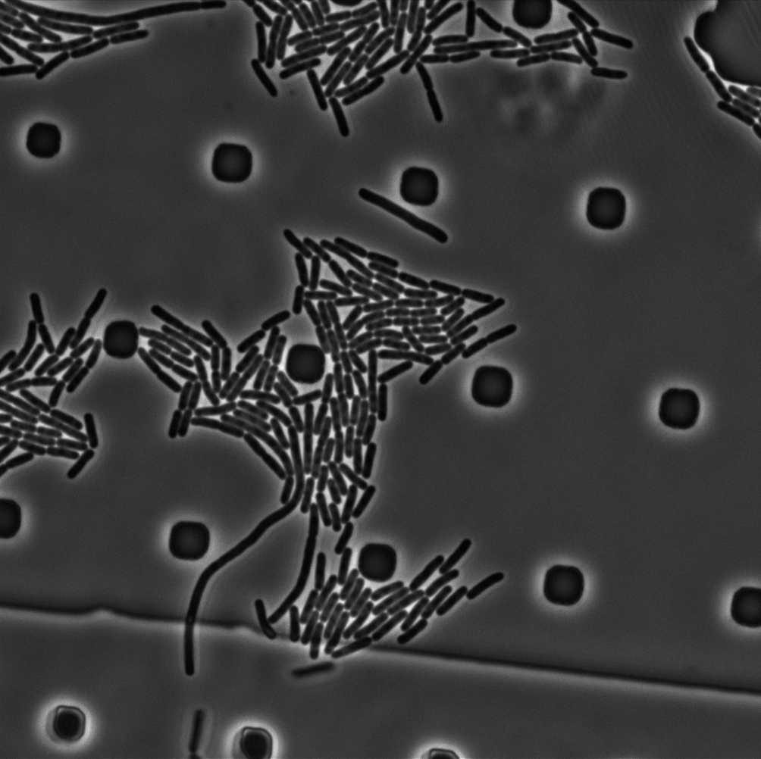
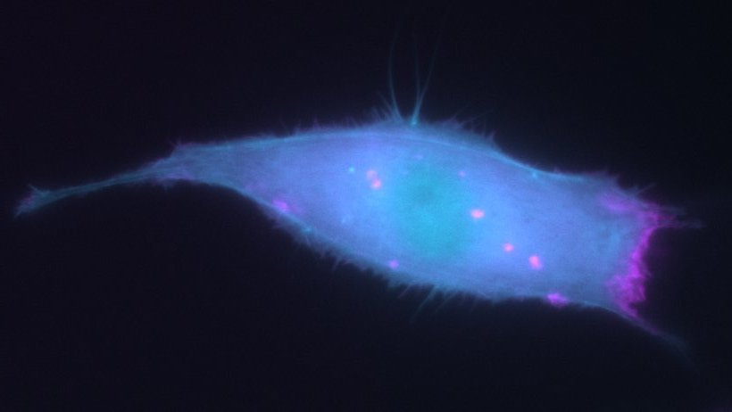


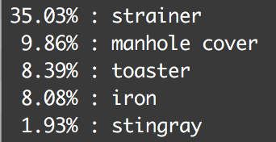
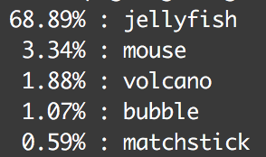
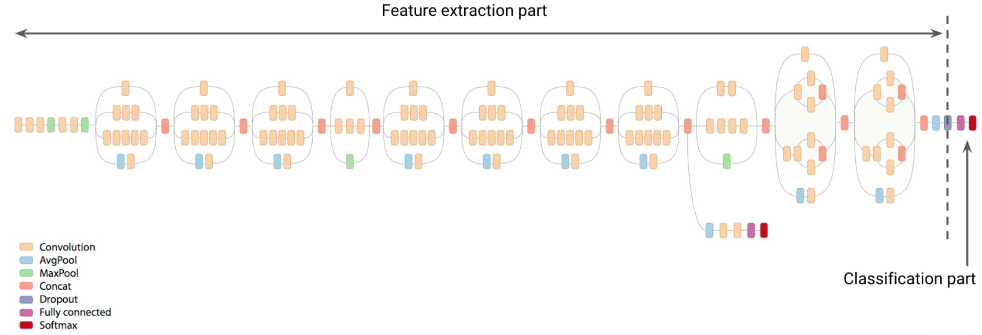
Achieving Pixel Level Classification of Cultured Mammalian Cells and Bacteria With Transfer Learning
R. Tyler McLaughlin, Kareem M. Mehrabiani, and David M. Zong
Motivation
Image Classification Results
True class:
Top 5 Predictions:
Top 5 Predictions:
Top 5 Predictions:
Model Specifications
Training and Test Accuracy
Inception v3 was trained on the task of image recognition, predicting the identity of 1000 classes of images, like “Dolphin”, “Dishwasher”, and “Zebra”, predicting the correct identity as one of the top 5 guesses with 97% accuracy, which is supposedly super-human. Unfortunately for biologists and biomedical , “cell” is not a category, so recognition.

